Slide 1
Introduction to Fog Computing: principles, architectures, and Applications

Slide 2
Introduction to Fog Computing: principles, architectures, and Applications
Internet of Things (IoT) environments consist of loosely connected devices that are connected through heterogeneous networks.
Such environments is to collect and process data from IoT devices in order to mine and detect patterns, or perform predictive analysis or optimization, and finally make smarter decisions in a timely manner.
Data in such environments can be classified into two categories:
• Little Data or Big Stream
• Big Data: persistent data and knowledge that is stored and archived in centralized cloud storage

Slide 3
Introduction to Fog Computing: principles, architectures, and Applications
IoT environments, need both Big Stream and Big Data for effective real-time analytics and decision making.
Cloud facility perfectly matches requirements of Big Data processing when data is stored in centralized cloud storage.
However, when data sources are distributed across multiple locations and low latency is unavoidable, in-cloud data processing. It fails to meet the requirements in such situations.

Slide 4
Introduction to Fog Computing: principles, architectures, and Applications
So the need for an alternative paradigm that is capable of bringing the computation to more computationally capable devices.
Those devices are geographically closer to the sensors than to the clouds, and that have connectivity to the Internet.
Such devices, which are at the edge of the network and therefore referred to as edge devices, can build local views of data flows and can aggregate data to be sent to the cloud for further offline analysis.
To this end, Fog computing has emerged

Slide 5
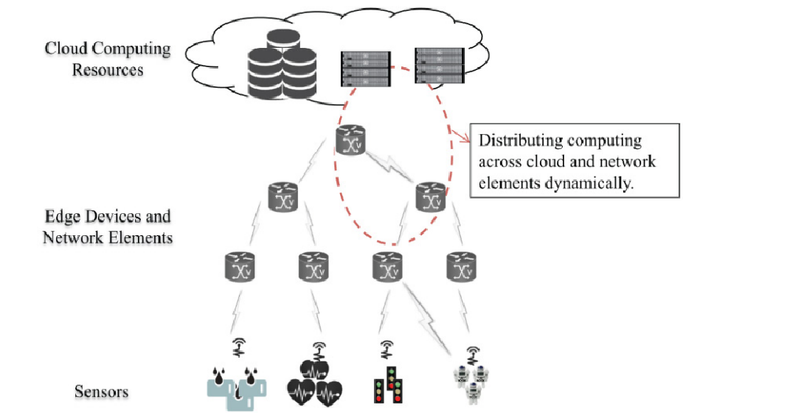
Introduction to Fog Computing: principles, architectures, and Applications
Fog Computing is a Distributed Computing Paradigm That Extends the Cloud Services to the Edge of the Network

Slide 6
Introduction to Fog Computing: principles, architectures, and Applications
DEFINITIONS AND CHARACTERISTICS OF FOG
We define Fog computing as a distributed computing paradigm that fundamentally extends the services provided by the cloud to the edge of the network.
Fog computing essentially involves components of an application running both in the cloud as well as in edge devices between sensors and the cloud, that is, in smart gateways, routers, or dedicated fog devices.
Fog computing supports distributed data analytics to address requirements of applications that need low latency with a wide and dense geographical distribution.

Slide 7
Introduction to Fog Computing: principles, architectures, and Applications
Advantages associated with Fog computing including the following:
Reduction of network traffic:
Sensors may collect data every few seconds. Therefore, it is neither efficient nor sensible to send all of this raw data to the cloud.
Hence, fog computing benefits here by providing a platform for filter and analysis of the data generated by these devices close to the edge, and for generation of local data views. This drastically reduces the traffic being sent to the cloud.
Suitable for IoT tasks and queries:
With the increasing number of smart devices, most of the requests pertain to the surroundings of the device. Hence, such requests can be served without the help of the global information present at the cloud

Slide 8
Introduction to Fog Computing: principles, architectures, and Applications
Advantages associated with Fog computing including the following:
Low-latency requirement: Mission-critical applications require real-time data processing. Some of the best examples of such applications are cloud robotics, control of fly-by-wire aircraft, or antilock brakes on a vehicle.
For a robot, motion control depends on the data collected by the sensors and the feedback of the control system.
Having the control system running on the cloud may make the sense-process-actuate loop slow as a result of communication failures. This is where fog computing helps, by performing the processing required for the control system very close to the robots—thus making real-time response possible.

Slide 9
Introduction to Fog Computing: principles, architectures, and Applications
Advantages associated with Fog computing including the following:
Scalability: Even with virtually infinite resources, the cloud may become the bottleneck if all the raw data generated by end devices is continually sent to it.
Since fog computing aims at processing incoming data closer to the data source itself, it reduces the burden of that processing on the cloud, thus addressing the scalability issues arising out of the increasing number of endpoints.

Slide 10
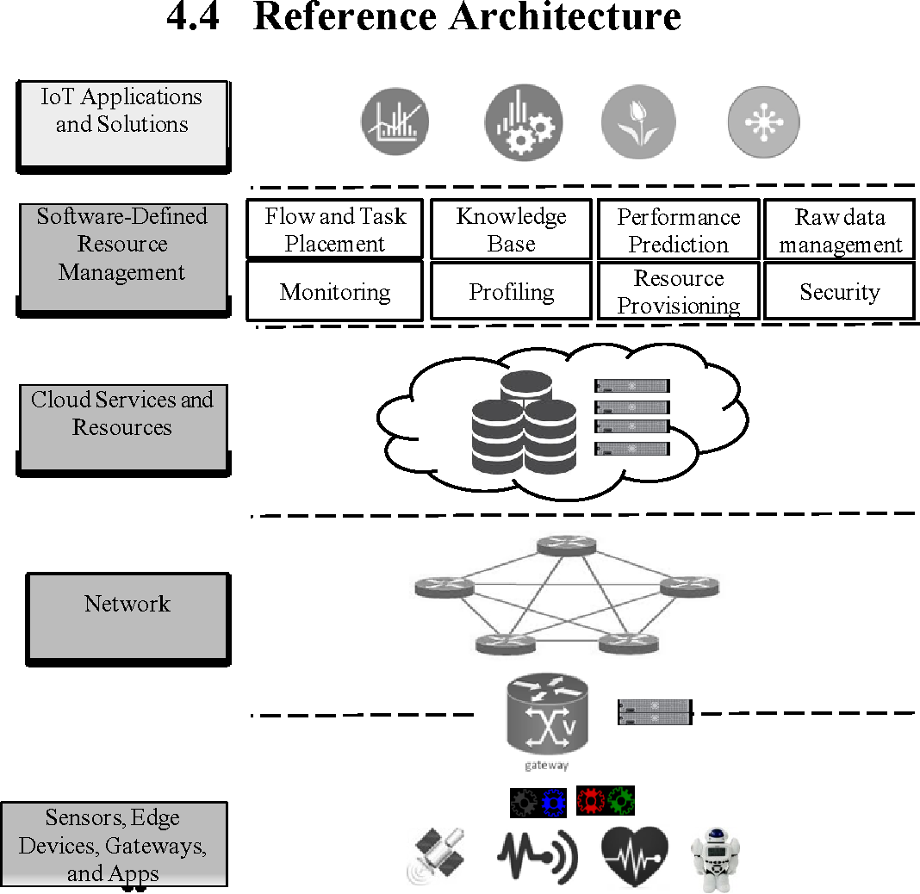
FOG-REFERENCE ARCHITECTURE

Slide 11
FOG-REFERENCE ARCHITECTURE
In the bottommost layer lays the end devices (sensors), as well as edge devices and gateways. This layer also includes apps that can be installed in the end devices to enhance their functionality.
Elements from this layer use the next layer, the network, for communicating among themselves, and between them and the cloud.
The next layer(cloud layer) contains the cloud services and resources that support resource management and processing of IoT tasks that reach the cloud.
On top of the cloud layer lays the resource management software that manages the whole infrastructure (Software defined resource management layer)and enables quality of Service to Fog Computing applications.
Finally, the topmost layer contains the applications (application layer) that leverage fog computing to deliver innovative and intelligent applications to end users.

Slide 12
FOG-REFERENCE ARCHITECTURE
Services of Software-Defined Resource Management layer
Flow and task placement: This component keeps track of the state of available cloud, Fog, and network to identify the best candidates to hold incoming tasks and flows for execution.
Knowledge Base: This component stores historical information about application demands and resource demands that can be leveraged by other services to support their decision-making process
Performance Prediction: This service utilizes information of the Knowledge- Base service to estimate the performance of available cloud resources. This information is used by the Resource Provisioning service to decide the amount of resources to be provisioned

Slide 13
FOG-REFERENCE ARCHITECTURE
Raw-Data Management: This service has direct access to the data sources and provides views from the data for other services
Monitoring: This service keeps track of the performance and status of applications and services, and supplies this information to other services as required.
Profiling: This service builds resource- and application-profiles based on information obtained from the Knowledge Base and Monitoring services.
Resource Provisioning: This service is responsible for acquiring cloud, Fog, and network resources for hosting the applications.
Security: This service supplies authentication, authorization, and cryptography, as required by services and applications.

